Slide 1
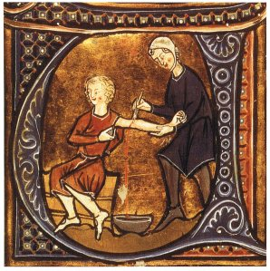
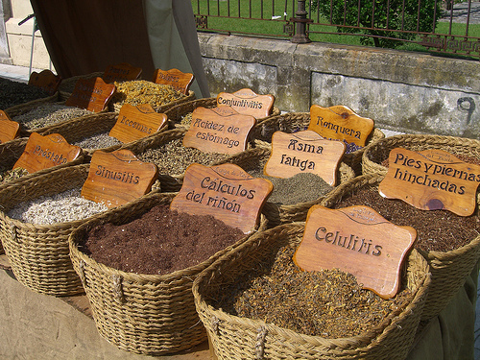
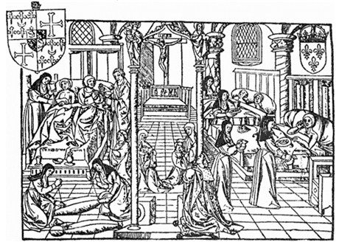
What is today’s lesson about? – paired discussion (1 minute) http://www.youtube.com/watch?v=cPkLhSVtPS4

Slide 2
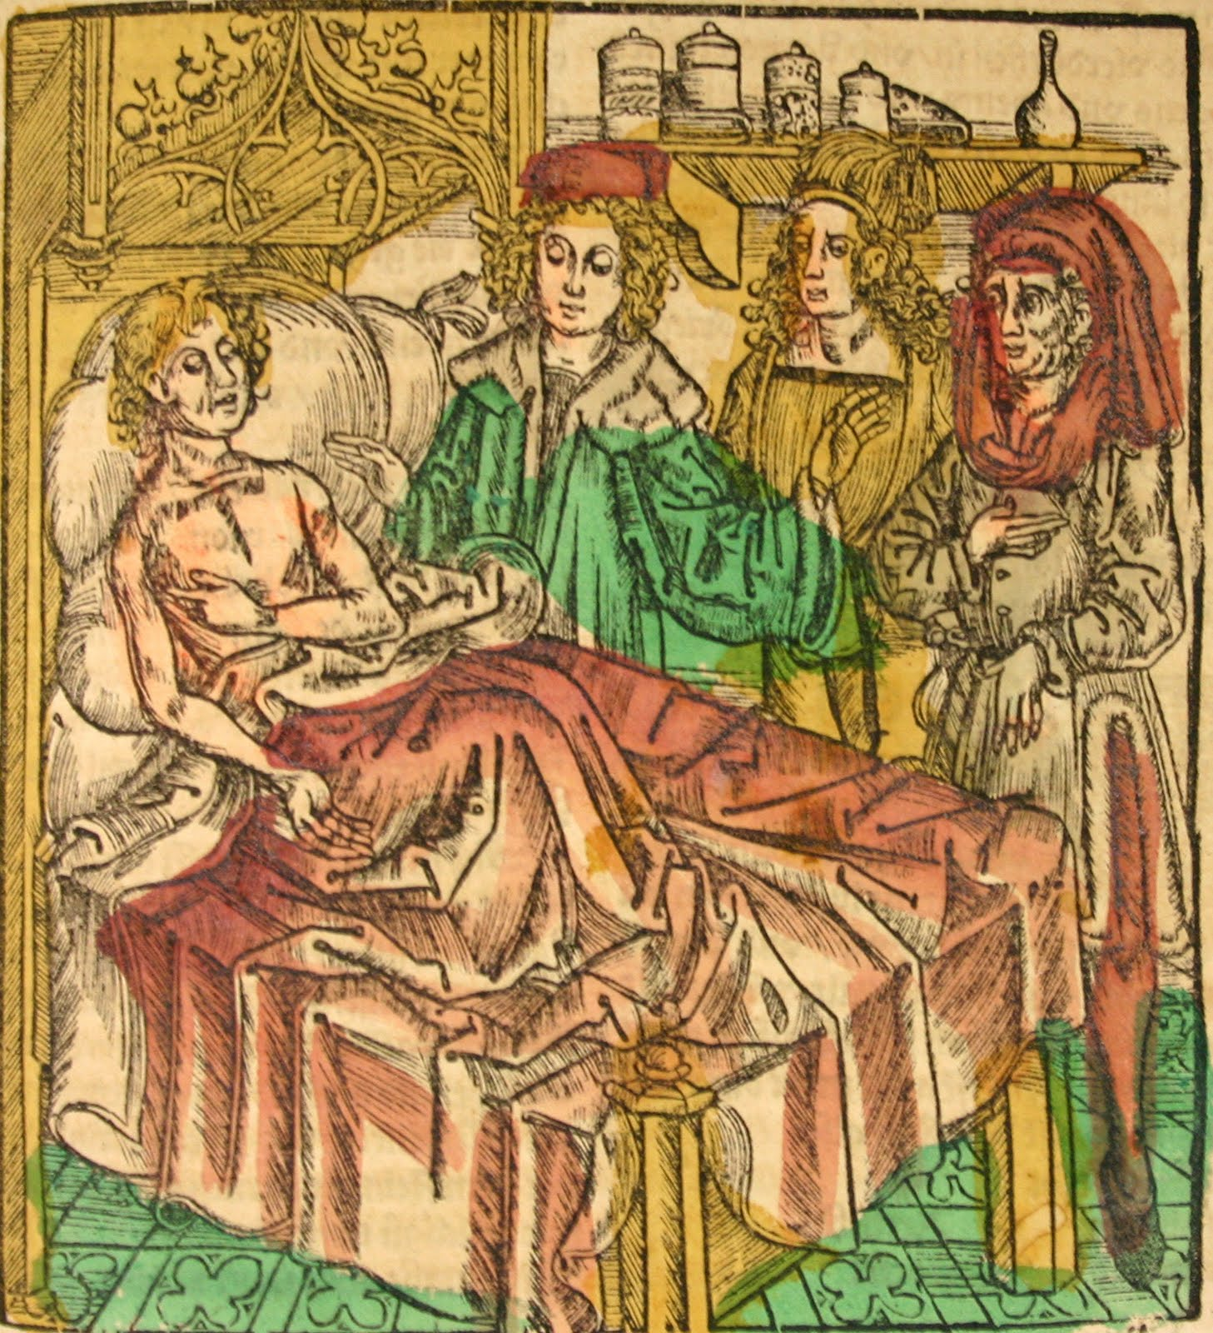
Medieval Medicine
Learning Outcomes:
1. Explore how people were medically treated during medieval times
2. Working in groups, teach each other about your topic

Slide 3
My expectations – Ms. Ruben
Put your hand up if you want to speak - No calling out
I expect good listening skills when others are talking
I expect every staff instruction to be followed without argument or delay

Slide 4
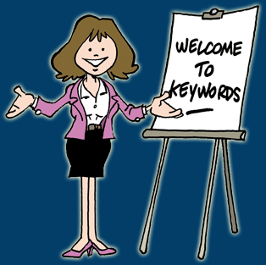
Keywords
Physician
Dissection
Barber-surgeons
Monasteries
Infectious
Anatomy

Slide 5
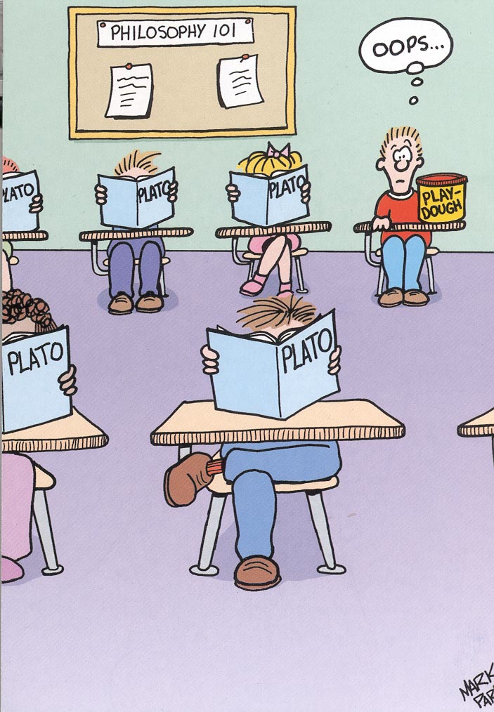
Peer Teaching
Allocate roles within the group: reader, writers, teacher, participants in discussion – 1 minute
Using the information sheet, each group must make complete their boxes – 10 mins
Two students from the group must
then go around to each table and those
staying in their seats must teach them
about their topic
5 minutes at each desk – timer to help
Learning Objective:
1. Explore how people were treated medically during medieval times
2. Working in groups, teach each other about your topic

Slide 6

Recap
Learning Objective:
1. Explore how people were treated medically during medieval times
2. Working in groups, teach each other about your topic

Slide 7
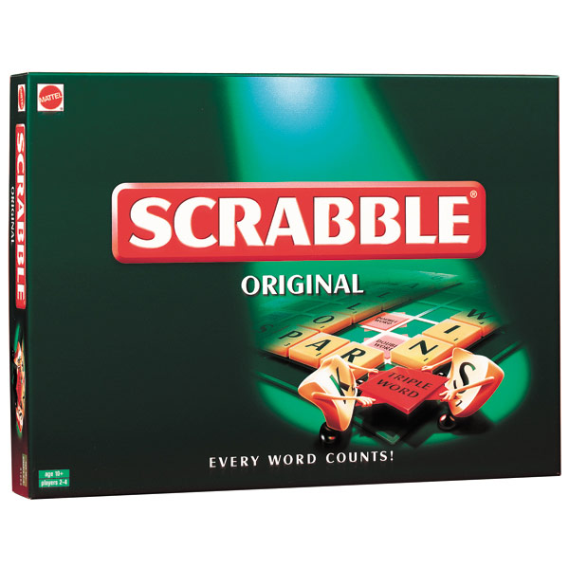
Scrabble
10
minutes
Write a letter of two paragraphs to a friend (you can have more than two paragraphs) on what you learnt this lesson
Your paragraphs must include the following words:-
Medieval (1 point), Doctors (1 point), Infectious (2 points), Dissection (3 points) & Barber-Surgeons (4 points)
Each word has a point. The aim is to get as many points as possible in your paragraphs
You must use every word at least once
Your paragraph must be relevant to the topic
Your paragraph must make sense e.g. Do not use the words randomly just to get more points
Each paragraph must be a minimum of 5 lines

Slide 8
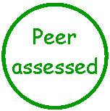
Success Criteria – Peer assessment – 5 minutes

Slide 9
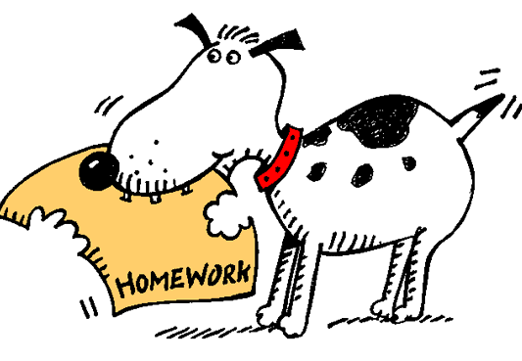
For further information
Visit BBC Bitesize
Learning Objective
1. Explore how people were treated medically during medieval times
2. Working in groups, teach each other about our topic

